Slide 1

AASD4011: Mathematical Concepts for Deep Learning
Keras Abstractions
Wikipedia

Slide 2
Our Python Code
90%
Keras
Data API
10%
TF low-level API
C++ API
Java API
…
Execution engine
CPU Kernels
GPU Kernels
TPU Kernels
…

Slide 3
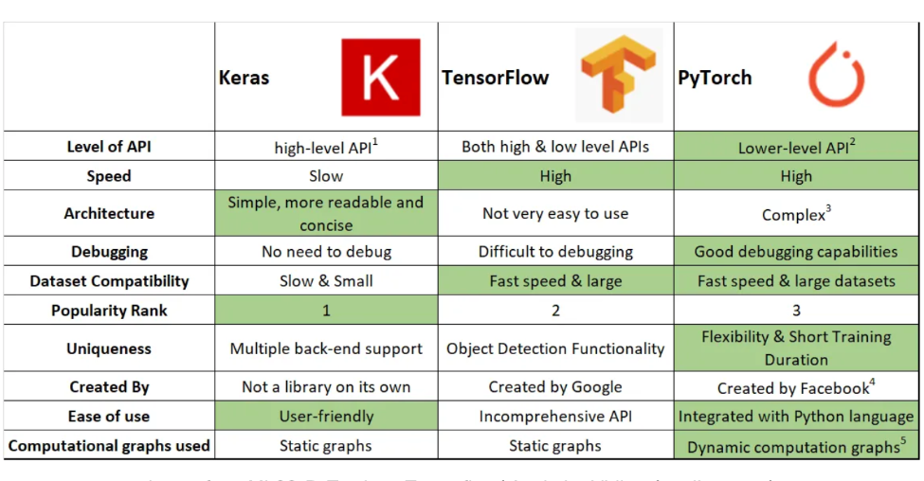
Image from ML03: PyTorch vs. Tensorflow | Analytics Vidhya (medium.com)

Slide 4
Step | Keras | Tensorflow
Model Definition | keras.Sequential | -
 | keras.layers | tf.nn
Optimizer Definition | keras.optimizers | -
Loss function Definition (+) | keras.losses model.compile | -
Training Loop | model.fit | -
Prediction | model.predict | -
- | model.evaluate | -
- | keras.models.save_model | tf.saved_model
Notes:
Tensorflow don’t offer abstractions for most operations. The way to go would be to define this with Python (as we done for the binary classification).
In particular, see discussion on implementing Optimizers in Core TF, which might be the more intricate of all
https://www.tensorflow.org/guide/core/optimizers_core

Slide 5
Step | Tensorflow | PyTorch
Model Definition | - | -
 | tf.nn | torch.nn
Optimizer Definition | - | torch.optim
Loss function Definition (+) | - | torch.nn
Training Loop | - | -
Prediction | - | -
- | - | -
- | tf.saved_model | torch.save torch.load
Notes:
Tensorflow don’t offer abstractions for most operations. The way to go would be to define this with Python (as we done for the binary classification).
In particular, see discussion on implementing Optimizers in Core TF, which might be the more intricate of all
https://www.tensorflow.org/guide/core/optimizers_core

